Slide 1

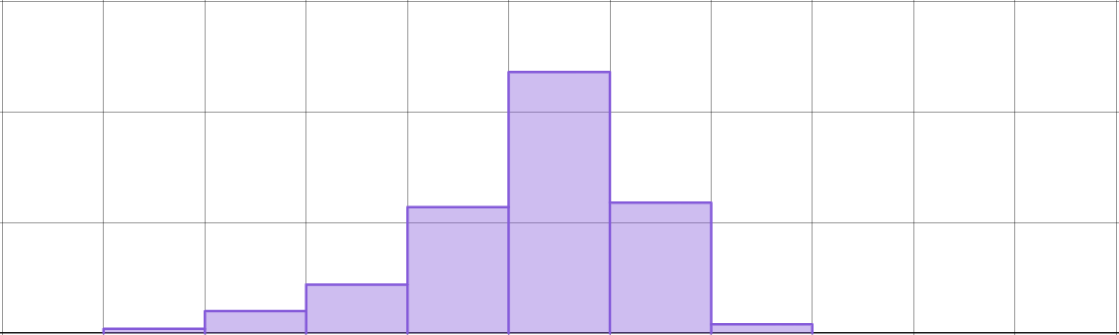
Studying climate change
Task A: Comparing data between different periods of time
1) The graphs show data from the Met Office and OSI SAF about sea ice in the Arctic for each month from 1979 to 2024.
150
1979 to 2001
frequency
100
50
0
-3
-2.5
-2
-1.5
-1
-0.5
0
0.5
1
1.5
2
150
2002 to 2024
frequency
100
50
0
-3
-2.5
-2
-1.5
-1
-0.5
0
0.5
1
1.5
2
Horizontal axes show the monthly Arctic sea ice extent expressed as a difference from the 1981-2010 average for each month separately (million km²).
a) What was the modal class for 1979 to 2001?
0 to 0.5 million km²
b) What was the modal class for 2002 to 2024?
-1 to -0.5 million km²
c) Did the extent of sea ice generally increase or decrease between the two periods of time? Explain your answer.
The extent of sea ice is generally less for 2002 to 2024 than for 1979 to 2001, so it generally decreased.
Example explanations for why:
The modal class is lower for 2002-2024 than for 1979-2001.
The data for 1979 to 2001 is between -1 and 1.5, while the data for 2002 to 2024 is between -2.5 and 0.5

Slide 2


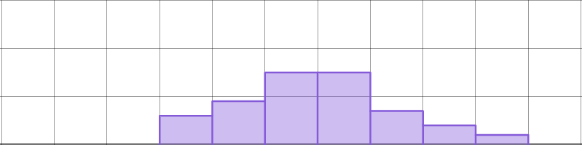
Studying climate change
2) The graphs show data from the Met Office and HadSST4 about sea-surface temperatures for each year from 1851 to 2024.
30
1851 to 1908
frequency
20
10
0
-1
-0.8
-0.6
-0.4
-0.2
0
0.2
0.4
0.6
0.8
1
30
1909 to 1966
frequency
20
10
0
-1
-0.8
-0.6
-0.4
-0.2
0
0.2
0.4
0.6
0.8
1
30
1967 to 2024
frequency
20
10
0
-1
-0.8
-0.6
-0.4
-0.2
0
0.2
0.4
0.6
0.8
1
Horizontal axes show the annual global mean sea-surface temperature expressed as a difference from 1981-2010 average (°C).
Compare the sea-surface temperatures for the three periods of time. Describe any conclusions that you can draw from the data.
Example 1:
The annual global mean sea-surface temperatures appeared to increase slightly between the first two time periods.
The modal class for each period of time is the same (-0.6 to -0.4). However the data for 1851 to 1908 is between -1 and -0.2, where as it is between -1 and 0 from 1909 to 1966.
Example 2:
For the majority of years from 1967 to 2024, the annual global sea-surface temperatures were higher than they were between 1851 and 1966.
The modal classes from 1967 to 2024 are between -0.2 and 0.2 Also the data from 1967 to 2024 is between -0.6 and 0.8
More precise methods can also be used to compare the datasets (e.g. mean or median) if pupils already know how to use them.

Slide 3
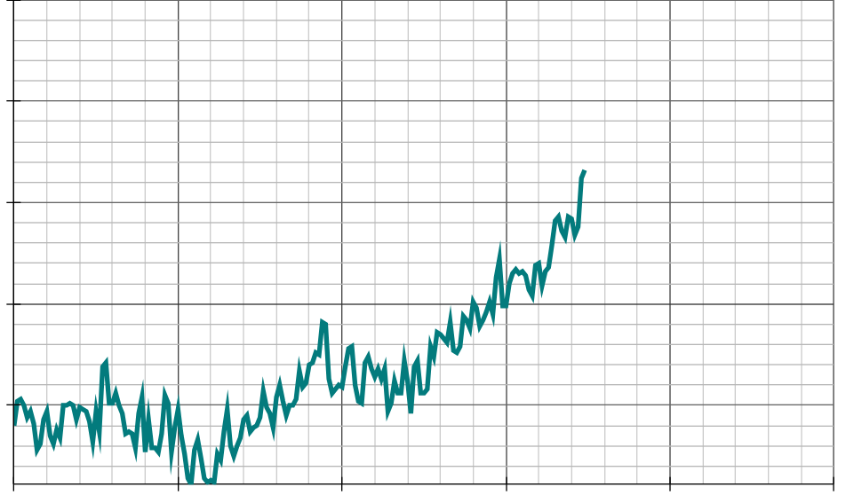
Studying climate change
Task B: Using data about sea ice to make predictions
1) The graphs show data from the Met Office and HadSST4 about sea-surface temperatures for each year from 1851 to 2024.
1.5
1.0
0.5
annual global mean sea-surface temperature expressed as a difference from 1981-2010 average (°C)
0.0
-0.5
1850
1900
1950
2000
2050
2100
year
a) Write down at least two observations that you make about any trends in the data.
Examples:
The global mean sea-surface temperatures remain relatively stable between 1850 and 1930.
There is an upward trend from 1920 to 1945.
The global mean sea-surface temperatures remain relatively stable between 1945 and 1980.
There is a clear upward trend from 1980 onwards.
b) If the trend in mean global sea-surface temperatures continues in the way it has since 1970, what range of data could we expect to observe in:
i) 2040?
ii) 2050?
iii) 2060?
0.5 to 0.8°C
0.65 to 0.95°C
0.8 to 1.1°C
Pupils’ answers may differ slightly from the values given.

Slide 4
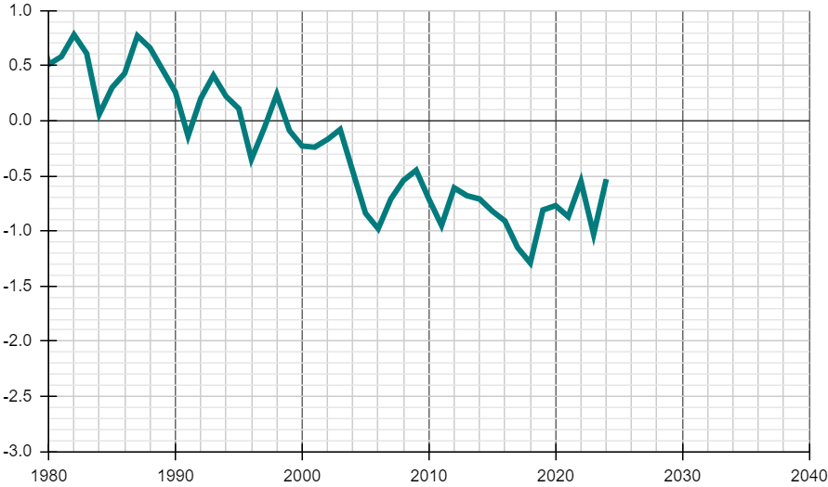
Studying climate change
2) The graph shows data from the Met Office and OSI SAF about sea ice in the Arctic for each January from 1980 to 2024.
1.0
0.5
0.0
-0.5
Arctic sea ice extent for January expressed as a difference from the 1981-2010 average for each January (million km²)
-1.5
-2.0
-2.5
-3.0
1980
1990
2000
2010
2020
2030
2040
year
a) Write down at least one observation that you make about any trends in the data.
Examples:
Overall, there is a downward trend from 1980 onwards.
The trend possibly changes from around 2006 to something slightly more stable.
b) If the trend in the extent of Arctic sea ice continues in the way it has since 1980, what range of data could we expect to see in:
i) 2030?
ii) 2035?
iii) 2040?
-2.5 to -1.6 km²
-2.7 to -1.8 km²
-2.9 to -2.0 km²
Pupils’ answers may differ slightly from the values given.
Mathematics in Education and Industry
v2.4

